Slide 1
Customer Discovery 6
ProviderNet
Jaden Del Rosario
Lydia Holleman
Lola Wood

Slide 2
Uniting Your Health With The Care You’re Covered For.
ProviderNet
ProviderNet is the only platform that unifies the healthcare journey into a single workflow. We’ve replaced the digital chaos of multiple portals with one simple login, giving patients and providers a guided care experience that finally transcends state lines.

Slide 3
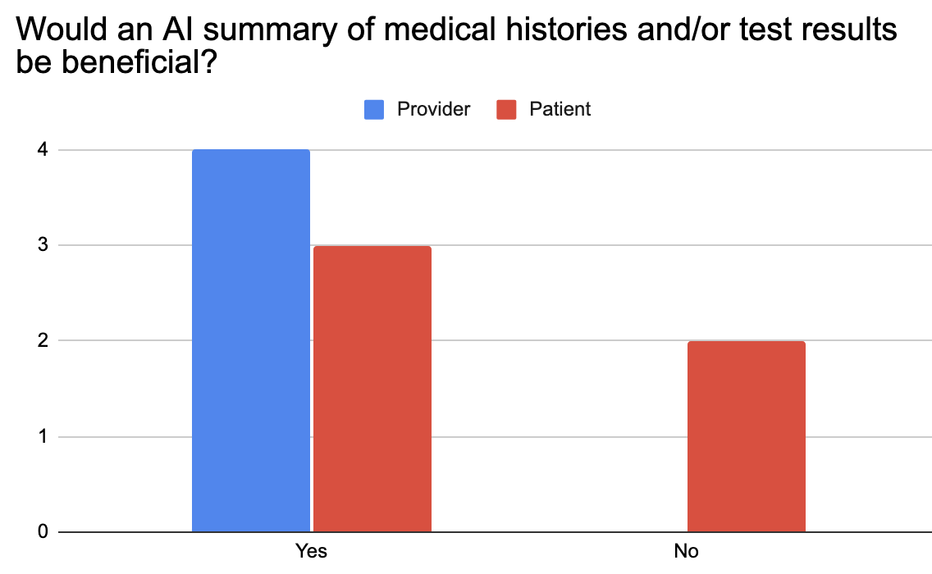
Opinions on AI summaries
AI Usage
Investing
All providers asked said an AI summary of records would help minimize errors due to misreading charts and reduce time to look for information - currently unorganized
Patients had mixed reviews with some saying they understand results already and others saying that would help understand next steps

Slide 4
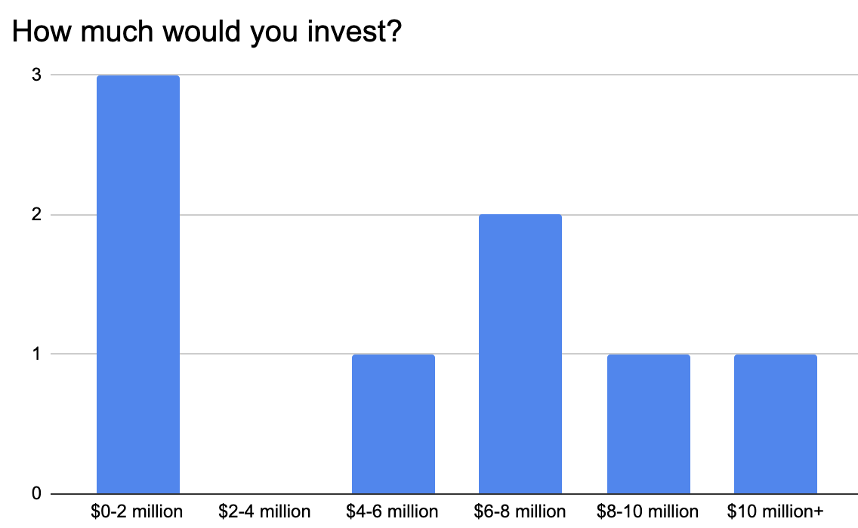
AI Usage
Investing
How much would you invest
Who we asked:
3 Investment Bankers
2 people who’ve previously invested in companies as family/friends
1 engineer
1 administrator at construction company
1 data scientist

